Slide 1
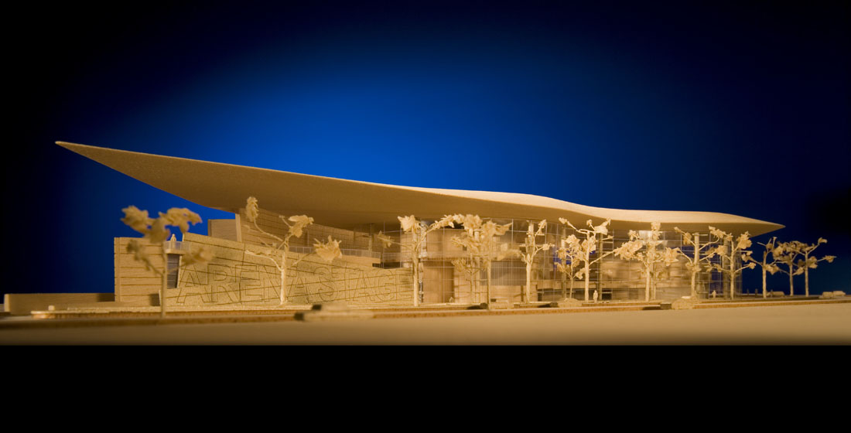
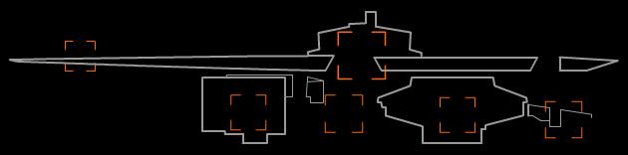
[ARENA STAGE] Washington, DC
JONI ANDERSON
Construction Management
AE Senior Thesis Presentation : Spring 2009
The Pennsylvania State University

Slide 2
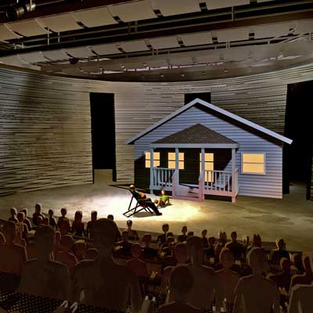
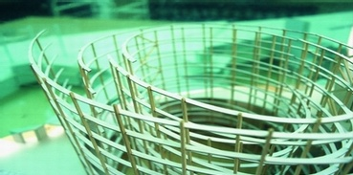
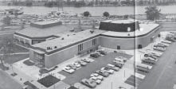
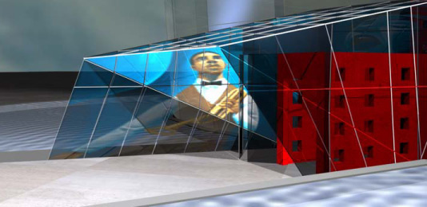
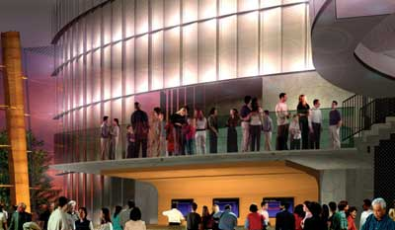
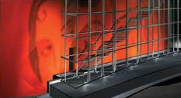
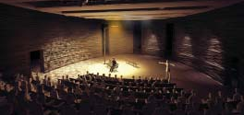
[PRESENTATION OUTLINE]
  Project Overview
  Introduction to Analyses
  Analysis I: Redesign of the Curtain Wall System
  Analysis III: Redesign of the Fichandler Stage Air Distribution System
  Conclusions
  Question & Answer
Construction Management
Spring 2009

Slide 3
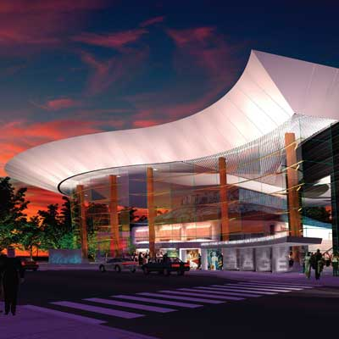
[PRESENTATION OUTLINE]
  Project Overview
  Introduction to Analyses
  Analysis I: Redesign of the Curtain Wall System
  Analysis III: Redesign of the Fichandler Stage Air Distribution System
  Conclusions
  Question & Answer
[PROJECT OVERVIEW]
  Owner:
    Washington Drama Society (Arena Stage)
  Occupancy Type:
  Performing Arts Center
  Size:
  200,000 SF
  Cost:
  $125 million
  Construction Dates:
  January 2008 – June 2010
Construction Management
Spring 2009

Slide 4
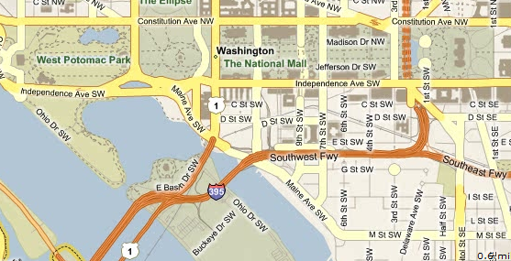
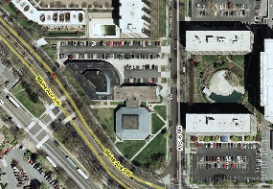
[PRESENTATION OUTLINE]
  Project Overview
  Introduction to Analyses
  Analysis I: Redesign of the Curtain Wall System
  Analysis III: Redesign of the Fichandler Stage Air Distribution System
  Conclusions
  Question & Answer
[PROJECT OVERVIEW]
  Owner:
    Washington Drama Society (Arena Stage)
  Occupancy Type:
  Performing Arts Center
  Size:
  200,000 SF
  Cost:
  $125 million
  Construction Dates:
  January 2008 – June 2010
[PROJECT LOCATION]
The Washington National Mall
Arena Stage
1101 6th Street SW
Washington, DC 20024
Construction Management
Spring 2009

Slide 5

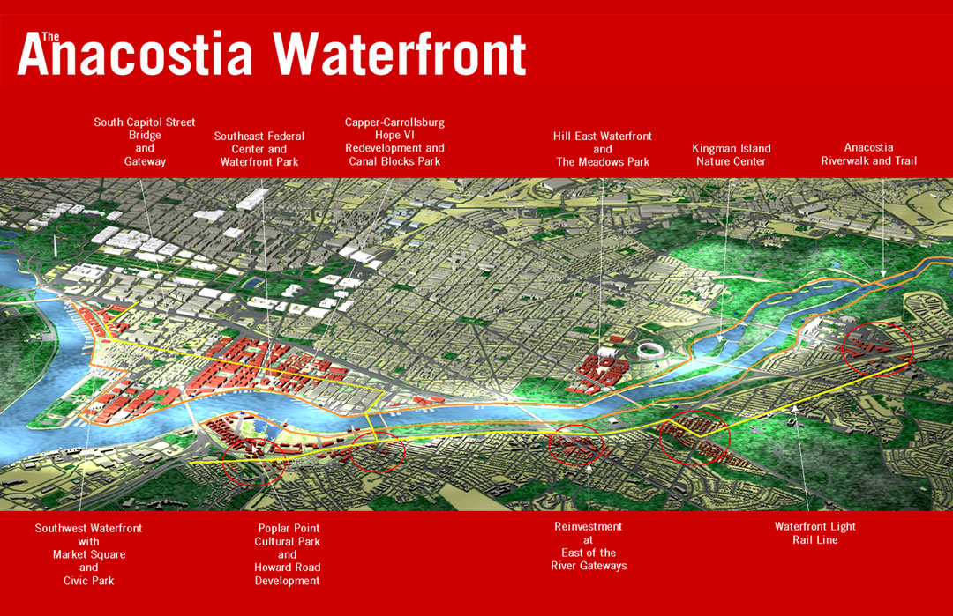
[PRESENTATION OUTLINE]
  Project Overview
  Introduction to Analyses
  Analysis I: Redesign of the Curtain Wall System
  Analysis III: Redesign of the Fichandler Stage Air Distribution System
  Conclusions
  Question & Answer
[ARENA STAGE & THE AWI]
Arena Stage
    Not-for-profit
    Largest producing theater in North America (American plays)
    First regional theater to:
      Transfer production to Broadway
      Receive Tony Award
    District of Columbia Inventory of Historic Sites
Anacostia Waterfront Initiative (AWI)
    Make Southwest DC a more alluring section of the city and join the ranks as a leading attraction
    City’s #1 economic priority
    Hope to have a contagious effect on other markets
    Restore • Connect • Play • Celebrate • Live
Construction Management
Spring 2009

Slide 6
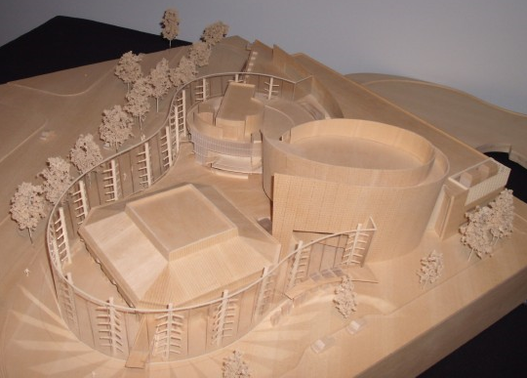
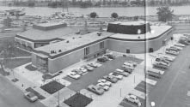
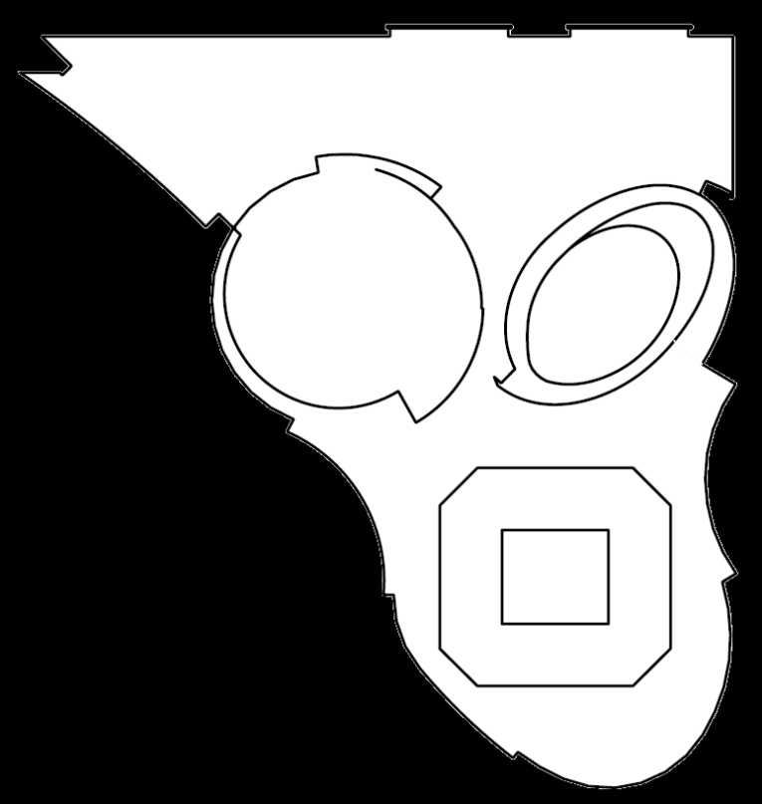
[PRESENTATION OUTLINE]
  Project Overview
  Introduction to Analyses
  Analysis I: Redesign of the Curtain Wall System
  Analysis III: Redesign of the Fichandler Stage Air Distribution System
  Conclusions
  Question & Answer
[PROJECT SCOPE]
Renovation
  Fichandler Theater (c. 1960)
  Kreeger Theater (c. 1971)
Expansion
  Cradle Theatre
  Back of House
  Parking Garage
  (1 story below grade)
  Lobby space
Back of
House
Kreeger
Cradle
Back of House
Fichandler
Kreeger
Cradle
Fichandler
Construction Management
Spring 2009

Slide 7
[PRESENTATION OUTLINE]
  Project Overview
  Introduction to Analyses
  Analysis I: Redesign of the Curtain Wall System
  Analysis III: Redesign of the Fichandler Stage Air Distribution System
  Conclusions
  Question & Answer
[PROJECT TEAM]
Owner
Arena Stage
Project Manager
KCM Inc.
General Contractor
Clark Construction Group, LLC
Architect
Bing Thom Architects
Engineers
Structural: Fast + Epp
Electrical: Stantec Consulting Ltd.
Mechanical: Yoneda & Associates
Subcontractors
Steel: Banker Steel Company, LLC
Concrete: Clark Concrete
Electrical: Truland Systems Corp.
Mechanical: Southland Industries
Construction Management
Spring 2009
Notes:
Arena Stage is being delivered as a modified bid and project proposal process. Due to the complexity and uniqueness of the project, Arena Stage chose not to use the traditional bid process.
Since the contract is a Guaranteed Maximum Price (GMP) based on an open book buyout with the owner involved, the only competitive comparison was that of the proposed fee and also a quantitative look at the General Conditions between the submitting GCs

Slide 8
[PRESENTATION OUTLINE]
  Project Overview
  Introduction to Analyses
  Analysis I: Redesign of the Curtain Wall System
  Analysis III: Redesign of the Fichandler Stage Air Distribution System
  Conclusions
  Question & Answer
[PROJECT TEAM]
[PROJECT PRIORITIES]
“The Next Stage Campaign”
  *Cost
    Funded by Donations
  *Schedule
    Grand Opening : 2010-2011 season
  *Quality
    High-end, sophisticated new building
Owner
Arena Stage
Project Manager
KCM Inc.
General Contractor
Clark Construction Group, LLC
Architect
Bing Thom Architects
Engineers
Structural: Fast + Epp
Electrical: Stantec Consulting Ltd.
Mechanical: Yoneda & Associates
Subcontractors
Steel: Banker Steel Company, LLC
Concrete: Clark Concrete
Electrical: Truland Systems Corp.
Mechanical: Southland Industries
Construction Management
Spring 2009

Slide 9
[PRESENTATION OUTLINE]
  Project Overview
  Introduction to Analyses
  Analysis I: Redesign of the Curtain Wall System
  Analysis III: Redesign of the Fichandler Stage Air Distribution System
  Conclusions
  Question & Answer
[ANALYSES INTRODUCTION]
Analysis I: Redesign of the Curtain Wall System
  Detailed design
  High cost
  Grueling coordination
Analysis II: Application of Photovoltaic Panels
  Critical Industry Issue
  Improve life-cycle cost
  Renewable energy
Analysis III: Redesign of the Fichandler Stage Air Distribution System
  Limited space
  Excess sheet metal duct
  High-throw air delivery
Construction Management
Spring 2009

Slide 10
[PRESENTATION OUTLINE]
  Project Overview
  Introduction to Analyses
  Analysis I: Redesign of the Curtain Wall System
  Analysis III: Redesign of the Fichandler Stage Air Distribution System
  Conclusions
  Question & Answer
[ANALYSIS I]
Redesign of the Curtain Wall System:
Elimination of the 4 Degree Slope
Back of
House
Kreeger
Cradle
Fichandler
Construction Management
Spring 2009

Slide 11
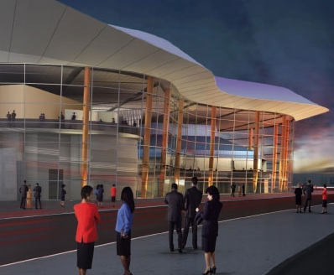
[PRESENTATION OUTLINE]
  Project Overview
  Introduction to Analyses
  Analysis I: Redesign of the Curtain Wall System
  Analysis III: Redesign of the Fichandler Stage Air Distribution System
  Conclusions
  Question & Answer
[ANALYSIS I: Curtain Wall]
Architectural and
structural component
Encloses the lobby
Terminal Points:
  Cradle Theater
  Kreeger café
45’-tall
Serpentine path
  Multiple radii
4 degree inclined slope
Back of
House
Kreeger
Cradle
Fichandler
Construction Management
Spring 2009

Slide 12
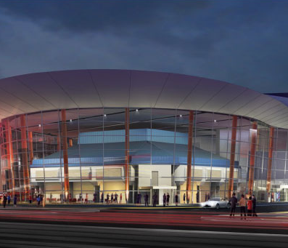
[PRESENTATION OUTLINE]
  Project Overview
  Introduction to Analyses
  Analysis I: Redesign of the Curtain Wall System
  Analysis III: Redesign of the Fichandler Stage Air Distribution System
  Conclusions
  Question & Answer
[ANALYSIS I: Discussion]
Problem
  The 4 degree slope of the curtain wall causes the glazing units to increase in size as the slope progresses, producing a combination of rectangular and trapezoidal pieces. The size and shape of the glazing units are extremely inconsistent, making the system very expensive and difficult to coordinate.
Objective
  Slightly adjust the architecture of the curtain wall by eliminating the 4 degree slope. The façade will then be vertically plumb along the serpentine path, and more uniform glazing unit sizes can be used along each face.
Construction Management
Spring 2009

Slide 13
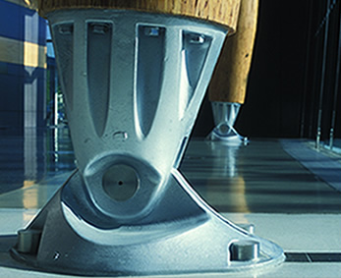

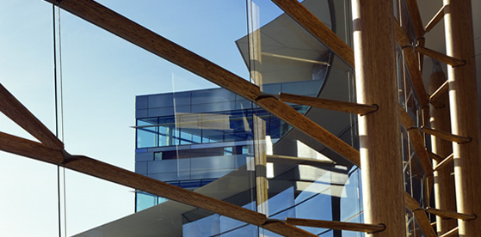
[PRESENTATION OUTLINE]
  Project Overview
  Introduction to Analyses
  Analysis I: Redesign of the Curtain Wall System
  Analysis III: Redesign of the Fichandler Stage Air Distribution System
  Conclusions
  Question & Answer
[ANALYSIS I: Support]
Support
  (18) Parallel strand lumber
  columns
    30” diameter
    36’ o.c.
  Cast ductile-iron bases
    Exaggerated pin
  Wood support arms
  Wood muntins
  Aluminum plates
  Stainless steel cables
    Support dead load of glass
Construction Management
Spring 2009

Slide 14
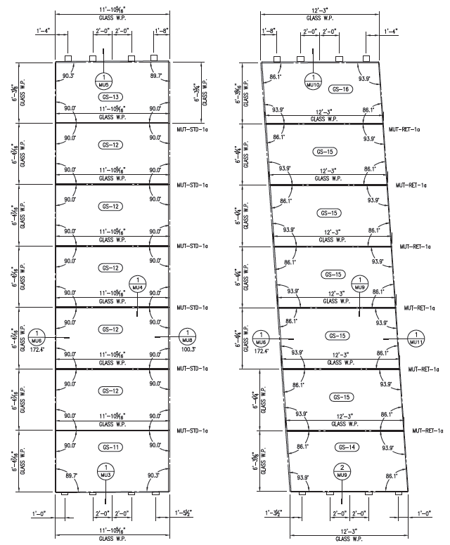
[PRESENTATION OUTLINE]
  Project Overview
  Introduction to Analyses
  Analysis I: Redesign of the Curtain Wall System
  Analysis III: Redesign of the Fichandler Stage Air Distribution System
  Conclusions
  Question & Answer
[ANALYSIS I: Glazing]
Glazing
  1 1/8”-thick insulated
  vision glass
  55 faces
    36 modules
      Rectangular
    19 infills
      Trapezoidal
  Typically 7 units high
  365 units
  850 lbs per unit
[ANALYSIS I: Glazing Take-Off Summary]
365 total glazing units
59.5%
repeating unit sizes
65.5%
rectangular units
40.5%
exclusively sized units
34.5%
trapezoidal units
Module
Infill
Construction Management
Spring 2009

Slide 15
[PRESENTATION OUTLINE]
  Project Overview
  Introduction to Analyses
  Analysis I: Redesign of the Curtain Wall System
  Analysis III: Redesign of the Fichandler Stage Air Distribution System
  Conclusions
  Question & Answer
[ANALYSIS I: Take-Off]
Elevation Matrix
  Excel
  Dimensioned all 365 Units
    Heights (Left & Right)
    Widths (Top & Bottom)
  Each column supports 4 faces
      (2) module faces
      (2) infill faces
  Portals = entryways into the building
Example
    Infill 6, Module 3, and Infill 5
[ANALYSIS I: Matrix Example]
Infill |  |  | Module |  |  | Module |  |  | Infill
6 |  |  | 3 |  |  | 3 |  |  | 5
 | 12'-5 3/32" |  |  | 11'-0" |  |  | 11'-0" |  |  | 12'-4 27/32"
6'-4 1/4" |  | 6'-4 1/4" | 6'-4 1/4" |  | 6'-5" | 6'-5" |  | 6'-4 1/4" | 6'-4 1/4" |  | 6'-4 1/4"
 | 12'-2 7/16" |  |  | 11'-0" |  |  | 11'-0" |  |  | 12'-2 27/32"
 | 12'-2 7/16" |  |  | 11'-0" |  |  | 11'-0" |  |  | 12'-2 27/32"
6'-4 3/8" |  | 6'-4 3/8" | 6'-4 3/8" |  | 6'-4 3/8" | 6'-4 3/8" |  | 6'-4 3/8" | 6'-4 3/8" |  | 6'-4 3/8"
 | 11'-11 13/16" |  |  | 11'-0" |  |  | 11'-0" |  |  | 12'-0 13/16"
 | 11'-11 13/16" |  |  | 11'-0" |  |  | 11'-0" |  |  | 12'-0 13/16"
6'-4 3/8" |  | 6'-4 3/8" | 6'-4 3/8" |  | 6'-4 3/8" | 6'-4 3/8" |  | 6'-4 3/8" | 6'-4 3/8" |  | 6'-4 3/8"
 | 11'-9 3/16" |  |  | 11'-0" |  |  | 11'-0" |  |  | 11'-10 13/16"
 | 11'-9 3/16" |  |  | 11'-0" |  |  | 11'-0" |  |  | 11'-10 13/16"
6'-4 3/8" |  | 6'-4 3/8" | 6'-4 3/8" |  | 6'-4 3/8" | 6'-4 3/8" |  | 6'-4 3/8" | 6'-4 3/8" |  | 6'-4 3/8"
 | 11'-6 9/16" |  |  | 11'-0" |  |  | 11'-0" |  |  | 11'-8 13/16"
 | 11'-6 9/16" |  |  | 11'-0" |  |  | 11'-0" |  |  | 11'-8 13/16"
6'-4 3/8" |  | 6'-4 3/8" | 6'-4 3/8" |  | 6'-4 3/8" | 6'-4 3/8" |  | 6'-4 3/8" | 6'-4 3/8" |  | 6'-4 3/8"
 | 11'-3 29/32" |  |  | 11'-0" |  |  | 11'-0" |  |  | 11'-6 25/32"
 | 11'-3 29/32" |  |  | 11'-0" |  |  | 11'-0" |  |  | 11'-6 25/32"
4'-5 1/16" |  | 4'-5 1/16" | 6'-4 3/8" |  | 6'-4 3/8" | 6'-4 3/8" |  | 6'-4 3/8" | 6'-4 3/8" |  | 6'-4 3/8"
 | 11'-2 3/32" |  |  | 11'-0" |  |  | 11'-0" |  |  | 11'-4 25/32"
 |  |  |  | 11'-0" |  |  | 11'-0" |  |  | 11'-4 25/32"
 | Portal |  | 6'-5 1/8" |  | 6'-4 3/8" | 6'-4 3/8" |  | 6'-5 1/8" | 6'-5 1/8" |  | 6'-5 1/8"
 |  |  |  | 11'-0" |  |  | 11'-0" |  |  | 11'-2 3/4"
Construction Management
Spring 2009

Slide 16
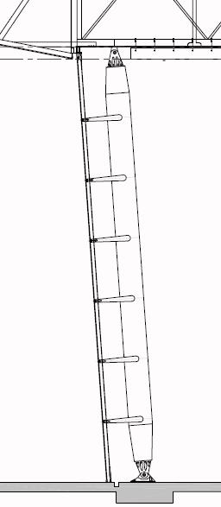
[PRESENTATION OUTLINE]
  Project Overview
  Introduction to Analyses
  Analysis I: Redesign of the Curtain Wall System
  Analysis III: Redesign of the Fichandler Stage Air Distribution System
  Conclusions
  Question & Answer
[ANALYSIS I: Redesign]
Vertical Face Heights
  By eliminating the 4 degree slope, the glass faces become too high from floor to ceiling
  Adjusted all faces for their vertically
  plumb height
4°
X = Y(cos4°)
Vertical Height
X
Sloped Height
Y
Construction Management
Spring 2009

Slide 17
[PRESENTATION OUTLINE]
  Project Overview
  Introduction to Analyses
  Analysis I: Redesign of the Curtain Wall System
  Analysis III: Redesign of the Fichandler Stage Air Distribution System
  Conclusions
  Question & Answer
[ANALYSIS I: Redesign]
Adjustment of Unit Heights
  Found most reoccurring height value : 6’-4 3/8”
  Applied it to as many units as possible
  Last unit became custom sized to fit the layout
Adjustment of Unit Widths
  Standard size of modules maintained
  Infills had most inconsistent width dimensions
  Base dimensions added together and averaged
      Between faces obstructed by portals
      Created repeating unit sizes
    This method prevented having to redesign the portals
[ANALYSIS I: New Matrix Example]
Infill |  |  | Module |  |  | Module |  |  | Infill
6 |  |  | 3 |  |  | 3 |  |  | 5
 | 11'-2 3/32" |  |  | 11'-0" |  |  | 11'-0" |  |  | 11'-9 3/8"
6'-4 3/8" |  | 6'-4 3/8" | 6'-4 3/8" |  | 6'-4 3/8" | 6'-4 3/8" |  | 6'-4 3/8" | 6'-4 3/8" |  | 6'-4 3/8"
 | 11'-2 3/32" |  |  | 11'-0" |  |  | 11'-0" |  |  | 11'-9 3/8"
 | 11'-2 3/32" |  |  | 11'-0" |  |  | 11'-0" |  |  | 11'-9 3/8"
6'-4 3/8" |  | 6'-4 3/8" | 6'-4 3/8" |  | 6'-4 3/8" | 6'-4 3/8" |  | 6'-4 3/8" | 6'-4 3/8" |  | 6'-4 3/8"
 | 11'-2 3/32" |  |  | 11'-0" |  |  | 11'-0" |  |  | 11'-9 3/8"
 | 11'-2 3/32" |  |  | 11'-0" |  |  | 11'-0" |  |  | 11'-9 3/8"
6'-4 3/8" |  | 6'-4 3/8" | 6'-4 3/8" |  | 6'-4 3/8" | 6'-4 3/8" |  | 6'-4 3/8" | 6'-4 3/8" |  | 6'-4 3/8"
 | 11'-2 3/32" |  |  | 11'-0" |  |  | 11'-0" |  |  | 11'-9 3/8"
 | 11'-2 3/32" |  |  | 11'-0" |  |  | 11'-0" |  |  | 11'-9 3/8"
6'-4 3/8" |  | 6'-4 3/8" | 6'-4 3/8" |  | 6'-4 3/8" | 6'-4 3/8" |  | 6'-4 3/8" | 6'-4 3/8" |  | 6'-4 3/8"
 | 11'-2 3/32" |  |  | 11'-0" |  |  | 11'-0" |  |  | 11'-9 3/8"
 | 11'-2 3/32" |  |  | 11'-0" |  |  | 11'-0" |  |  | 11'-9 3/8"
6'-4 3/8" |  | 6'-4 3/8" | 6'-4 3/8" |  | 6'-4 3/8" | 6'-4 3/8" |  | 6'-4 3/8" | 6'-4 3/8" |  | 6'-4 3/8"
 | 11'-2 3/32" |  |  | 11'-0" |  |  | 11'-0" |  |  | 11'-9 3/8"
 | 11'-2 3/32" |  |  | 11'-0" |  |  | 11'-0" |  |  | 11'-9 3/8"
4'-3 7/8" |  | 4'-3 7/8" | 6'-4 3/8" |  | 6'-4 3/8" | 6'-4 3/8" |  | 6'-4 3/8" | 6'-4 3/8" |  | 6'-4 3/8"
 | 11'-2 3/32" |  |  | 11'-0" |  |  | 11'-0" |  |  | 11'-9 3/8"
 |  |  |  | 11'-0" |  |  | 11'-0" |  |  | 11'-9 3/8"
 | Portal |  | 6'-3 3/4" |  | 6'-3 3/4" | 6'-3 3/4" |  | 6'-3 3/4" | 6'-3 3/4" |  | 6'-3 3/4"
 |  |  |  | 11'-0" |  |  | 11'-0" |  |  | 11'-9 3/8"
Construction Management
Spring 2009

Slide 18
[PRESENTATION OUTLINE]
  Project Overview
  Introduction to Analyses
  Analysis I: Redesign of the Curtain Wall System
  Analysis III: Redesign of the Fichandler Stage Air Distribution System
  Conclusions
  Question & Answer
[ANALYSIS I: Results]
Analyzed support and glazing separately.
Considered Impact on:
  Engineering Design
  Detailing (connections)
  Material
  Shop Fabrication
  Site
Construction Management
Spring 2009

Slide 19
[PRESENTATION OUTLINE]
  Project Overview
  Introduction to Analyses
  Analysis I: Redesign of the Curtain Wall System
  Analysis III: Redesign of the Fichandler Stage Air Distribution System
  Conclusions
  Question & Answer
[ANALYSIS I: Results]
Support
Cost
[ANALYSIS I: Results]
Support
Expected Savings
Only 1.4% of cost.
Component | Percentage of Overall Cost | Cost
Engineering Design | 10% | $390,000
Detailing | 10% | $390,000
Material | 30% | $1,170,000
Shop Fabrication | 25% | $975,000
Site | 25% | $975,000
Total |  | $3,900,000
Component | Percentage of Overall Cost | Expected Decrease | Expected Savings | Adjusted Cost
Engineering Design | 10% | 5% of 10% | $19,500 | $370,500
Detailing | 10% | 3% of 10% | $11,700 | $378,300
Material | 30% | 2% of 30% | $23,400 | $1,146,600
Shop Fabrication | 25% | 0% of 25% | $0 | $975,000
Site | 25% | 0% of 25% | $0 | $975,000
Total |  |  | $54,600 | $3,845,400
Construction Management
Spring 2009

Slide 20
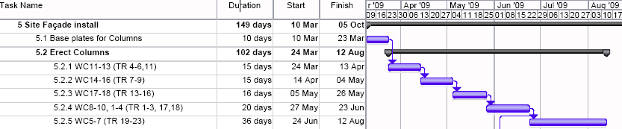
[PRESENTATION OUTLINE]
  Project Overview
  Introduction to Analyses
  Analysis I: Redesign of the Curtain Wall System
  Analysis III: Redesign of the Fichandler Stage Air Distribution System
  Conclusions
  Question & Answer
[ANALYSIS I: Results]
Support
Installation
No change. Will still require 112 days to install.
Construction Management
Spring 2009

Slide 21
[PRESENTATION OUTLINE]
  Project Overview
  Introduction to Analyses
  Analysis I: Redesign of the Curtain Wall System
  Analysis III: Redesign of the Fichandler Stage Air Distribution System
  Conclusions
  Question & Answer
[ANALYSIS I: Results]
Glazing
Cost
[ANALYSIS I: Results]
Glazing
Expected Savings
32% cost reduction.
Component | Percentage of Overall Cost | Cost
Engineering Design | 10% | $350,000
Detailing | 10% | $350,000
Material | 30% | $1,050,000
Shop Fabrication | 25% | $875,000
Site | 25% | $875,000
Total |  | $3,500,000
Component | Percentage of Overall Cost | Expected Decrease | Expected Savings | Adjusted Cost
Engineering Design | 10% | 45% of 10% | $157,500 | $192,500
Detailing | 10% | 30% of 10% | $105,000 | $245,000
Material | 30% | 10% of 30% | $105,000 | $945,000
Shop Fabrication | 25% | 57% of 25% | $498,750 | $376,250
Site | 25% | 29% of 25% | $253,750 | $621,250
Total |  |  | $1,120,000 | $2,380,000
Construction Management
Spring 2009
Notes:
Based on a VE idea from Clark to use 90 degree returns for the curtain wall

Slide 22
[PRESENTATION OUTLINE]
  Project Overview
  Introduction to Analyses
  Analysis I: Redesign of the Curtain Wall System
  Analysis III: Redesign of the Fichandler Stage Air Distribution System
  Conclusions
  Question & Answer
[ANALYSIS I: Results]
Glazing
Installation
  Sequences (19 total)
    (1) infill and (2) adjacent modules
    Approximately (21) units each
  2 main activities
    Construction of support and framing (3 days each)
      57 days total
    Placement of glazing (4 days each)
      76 days total
  Total Schedule: 133 days
Construction Management
Spring 2009

Slide 23
[PRESENTATION OUTLINE]
  Project Overview
  Introduction to Analyses
  Analysis I: Redesign of the Curtain Wall System
  Analysis III: Redesign of the Fichandler Stage Air Distribution System
  Conclusions
  Question & Answer
[ANALYSIS I: Results]
Glazing
Installation Comparison
50% reduction in installation time.
 | Original Design | Proposed Design
Framing/Support (1 Sequence) | 3 days | 1.5 days
Glazing Erection (1 Sequence) | 4 days | 2 days
Total (19 Sequences) | 133 days | 66.5 days
Construction Management
Spring 2009

Slide 24
[PRESENTATION OUTLINE]
  Project Overview
  Introduction to Analyses
  Analysis I: Redesign of the Curtain Wall System
  Analysis III: Redesign of the Fichandler Stage Air Distribution System
  Conclusions
  Question & Answer
[ANALYSIS I: Constructability]
Constructability Discussion
  Long lead time item
    Damaged units difficult to replace
  Coordination nightmare
    365 units
    No interchangeable locations
  Setting on a 4 degree slope
    Multiple radii
Construction Management
Spring 2009

Slide 25
[PRESENTATION OUTLINE]
  Project Overview
  Introduction to Analyses
  Analysis I: Redesign of the Curtain Wall System
  Analysis III: Redesign of the Fichandler Stage Air Distribution System
  Conclusions
  Question & Answer
[ANALYSIS I: Constructability]
Constructability Discussion
  Long lead time item
    Damaged units difficult to replace
  Coordination nightmare
    365 units
    No interchangeable locations
  Setting on a 4 degree slope
    Multiple radii
[ANALYSIS I: Architecture]
Architectural Discussion
  Prominent feature
  Owner reluctant to change
    Fear it will compromise quality
  Congruence with the Cradle Theater
    4 degree slope
Construction Management
Spring 2009

Slide 26
[PRESENTATION OUTLINE]
  Project Overview
  Introduction to Analyses
  Analysis I: Redesign of the Curtain Wall System
  Analysis III: Redesign of the Fichandler Stage Air Distribution System
  Conclusions
  Question & Answer
[ANALYSIS I: Recommendation]
Decision must be made by Arena Stage.
  Change in architectural appearance
  Coordination and installation greatly simplified
  Installation
  Saved 66.5 days (27% of total schedule)
  50% reduction in installation of glazing
  Cost
  $1,174,600 saved (16% of total cost)
  32% reduction in cost of glazing
Construction Management
Spring 2009

Slide 27
[PRESENTATION OUTLINE]
  Project Overview
  Introduction to Analyses
  Analysis I: Redesign of the Curtain Wall System
  Analysis III: Redesign of the Fichandler Stage Air Distribution System
  Conclusions
  Question & Answer
[ANALYSIS III]
Redesign of the Fichandler Stage
Air Distribution System
Back of
House
Kreeger
Cradle
Fichandler
Construction Management
Spring 2009

Slide 28
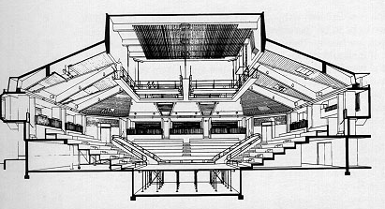
[PRESENTATION OUTLINE]
  Project Overview
  Introduction to Analyses
  Analysis I: Redesign of the Curtain Wall System
  Analysis III: Redesign of the Fichandler Stage Air Distribution System
  Conclusions
  Question & Answer
[ANALYSIS III: The Fichandler]
The “Fich”
Originally built in 1960
Architect Harry Weese
Most well known icon of Arena Stage
Theater-in-the-round (surrounded by audience on all four sides)
Construction Management
Spring 2009

Slide 29
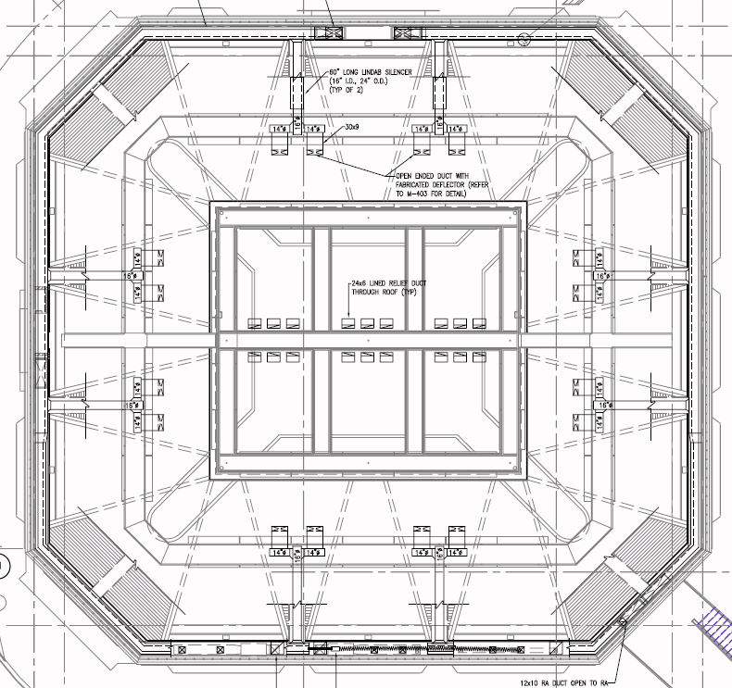
[PRESENTATION OUTLINE]
  Project Overview
  Introduction to Analyses
  Analysis I: Redesign of the Curtain Wall System
  Analysis III: Redesign of the Fichandler Stage Air Distribution System
  Conclusions
  Question & Answer
[ANALYSIS III: Current Design]
(1) Air Handling Unit – Supply Air Flow: 10,500 cfm
Sheet Metal Duct – 618 LF
Ring duct plenum
(8) Branch ducts above wood ceiling
(16) Open diffusers with hinged air deflectors
Ring Duct Plenum
Catwalk
Duct Size | Length (LF)
16x16 | 55
20x20 | 140
20x26 | 75
20x40 | 245
38x11 | 55
45° Angles | (16) 3
Total Run of Duct (LF) | 618
Stage (Below)
Branch Ducts (8 typ.)
Construction Management
Spring 2009

Slide 30
[PRESENTATION OUTLINE]
  Project Overview
  Introduction to Analyses
  Analysis I: Redesign of the Curtain Wall System
  Analysis III: Redesign of the Fichandler Stage Air Distribution System
  Conclusions
  Question & Answer
[ANALYSIS III: Current Design]
Installation
Cost
Man Hours | Week(s) | Crew Size (men)
532 | 3 | 4
 | Unit | Multiplier | Expanded
Material | $28/LF | 618 LF | $17,304
Labor | $57.68/hr (budgeted labor rate) | 532 hrs | $30,686
Total Cost (to engineer, furnish, and install) |  |  | $47,990
Construction Management
Spring 2009

Slide 31
[PRESENTATION OUTLINE]
  Project Overview
  Introduction to Analyses
  Analysis I: Redesign of the Curtain Wall System
  Analysis III: Redesign of the Fichandler Stage Air Distribution System
  Conclusions
  Question & Answer
[ANALYSIS III: Discussion]
Problem
The ring duct plenum and the branch ducts are difficult to install due to the limited amount of space in the Fichandler. This design also requires a lot of sheet metal, which is expensive and, when supplying air at a high-throw, has the potential to be noisy.
Objective
To redesign the current mechanical system of the Fichandler stage using fabric duct suspended beneath the catwalk. This will provide closer air distribution, ease installation, reduce installation time, and reduce the overall cost of the system.
Ring Duct Plenum
Catwalk
Stage (Below)
Branch Ducts (8 typ.)
Construction Management
Spring 2009
Notes:
considering the dimensions of the stage that it is conditioning (35’-6” x 29’-6”).

Slide 32
[PRESENTATION OUTLINE]
  Project Overview
  Introduction to Analyses
  Analysis I: Redesign of the Curtain Wall System
  Analysis III: Redesign of the Fichandler Stage Air Distribution System
  Conclusions
  Question & Answer
[ANALYSIS III: Redesign]
STEP 1: Series/Shape
  2 Possible Shapes
    Cylindrical
      High open ceilings
      Few obstructions
    Surface Mount (D-Shape)
      Flush mount
      Ceilings lower than 14 feet
DUCTSOX DESIGN STEPS
STEP 1: Series/Shape
STEP 2: Design Layout
STEP 3: Fabric
STEP 4: Air Dispersion
STEP 5: Suspension
Construction Management
Spring 2009

Slide 33
[PRESENTATION OUTLINE]
  Project Overview
  Introduction to Analyses
  Analysis I: Redesign of the Curtain Wall System
  Analysis III: Redesign of the Fichandler Stage Air Distribution System
  Conclusions
  Question & Answer
[ANALYSIS III: Redesign]
STEP 2: Design Layout
  Half of ring duct plenum to remain along beam shelf
  Terminate at catwalk bridge
  Size: 20x40
  Each branch: 5,250 cfm
Sheet Metal Duct
Catwalk
Fabric Duct
Fabric Duct
Stage (Below)
Duct Size | Length (LF)
20x40 | 170
45° Angles | (4) 3
Rectangular to Round Duct Transition | (2) 2
Total Run of Sheet Metal Duct (LF) | 186
DUCTSOX DESIGN STEPS
STEP 1: Series/Shape
STEP 2: Design Layout
STEP 3: Fabric
STEP 4: Air Dispersion
STEP 5: Suspension
Construction Management
Spring 2009

Slide 34
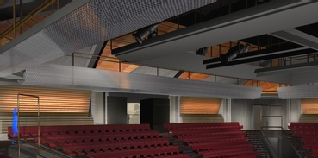
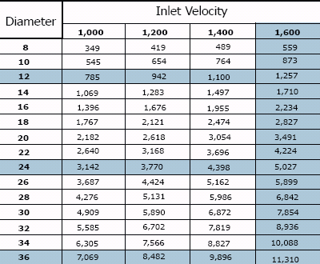
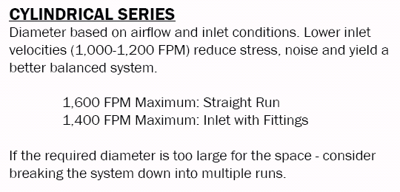
[PRESENTATION OUTLINE]
  Project Overview
  Introduction to Analyses
  Analysis I: Redesign of the Curtain Wall System
  Analysis III: Redesign of the Fichandler Stage Air Distribution System
  Conclusions
  Question & Answer
[ANALYSIS III: Redesign]
STEP 2: Design Layout
  Diameter: 30”
  Low inlet velocity: 1,070 fpm (< 1,200 fpm)
DUCTSOX DESIGN STEPS
STEP 1: Series/Shape
STEP 2: Design Layout
STEP 3: Fabric
STEP 4: Air Dispersion
STEP 5: Suspension
Construction Management
Spring 2009

Slide 35
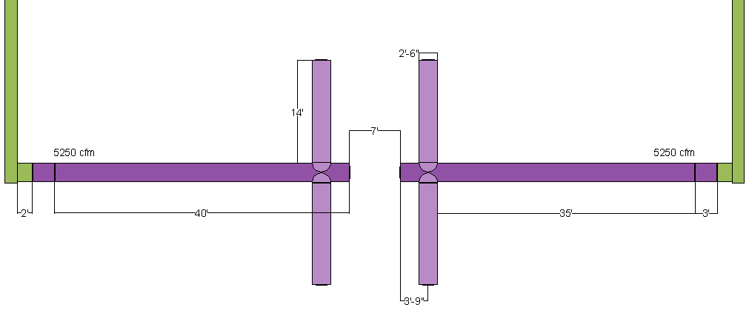
[PRESENTATION OUTLINE]
  Project Overview
  Introduction to Analyses
  Analysis I: Redesign of the Curtain Wall System
  Analysis III: Redesign of the Fichandler Stage Air Distribution System
  Conclusions
  Question & Answer
[ANALYSIS III: Redesign]
STEP 2: Design Layout
  Total length of fabric duct: 142’
Inlet Duct: (2) 20x40 @ 5250 cfm each
Rectangular to Round Duct Transition: (2) 2’
Fabric Duct Dimensions
Diameter | 2’-6” (30”)
Elevation Transition | (2) 3’
Long Run | (2) 40’ (7’ gap between)
Short Run | (4) 14’
Total Length | 142’
DUCTSOX DESIGN STEPS
STEP 1: Series/Shape
STEP 2: Design Layout
STEP 3: Fabric
STEP 4: Air Dispersion
STEP 5: Suspension
Construction Management
Spring 2009

Slide 36
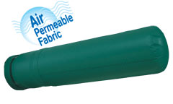
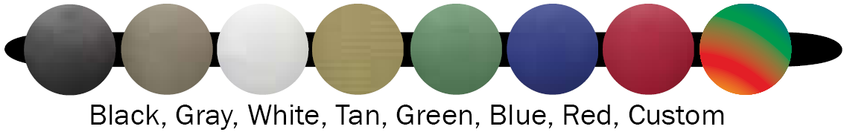
[PRESENTATION OUTLINE]
  Project Overview
  Introduction to Analyses
  Analysis I: Redesign of the Curtain Wall System
  Analysis III: Redesign of the Fichandler Stage Air Distribution System
  Conclusions
  Question & Answer
[ANALYSIS III: Redesign]
STEP 3: Fabric
  DuctSox System Recommendation
  CF = comfort-flow
  HT = high-throw
  Chose Verona fabric
    Polyester
    All-purpose
    Air-permeable
    Fire retardant
    Commercial-quality
                Color: Black
                Match rigging, catwalk, acoustical reflectors, and lighting fixtures
Application | Fabric Options | Model Options | Suspension and Attachment Options
Auditorium, Sports Arena, Convention Center, Church | Verona | CF | Galvanized Cable and Nylon Snap Clips
 | TufTex or DuraTex Sedona-Xm | CF or HT
DUCTSOX DESIGN STEPS
STEP 1: Series/Shape
STEP 2: Design Layout
STEP 3: Fabric
STEP 4: Air Dispersion
STEP 5: Suspension
Construction Management
Spring 2009

Slide 37
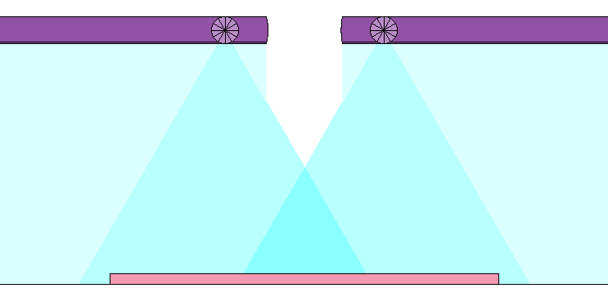

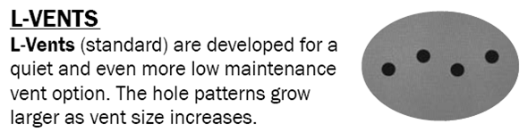
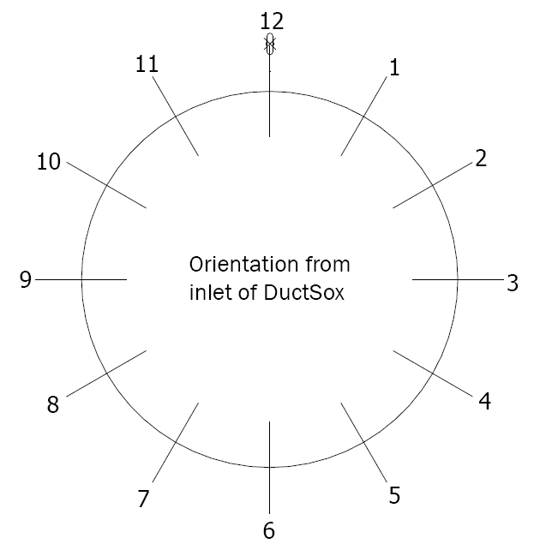
[PRESENTATION OUTLINE]
  Project Overview
  Introduction to Analyses
  Analysis I: Redesign of the Curtain Wall System
  Analysis III: Redesign of the Fichandler Stage Air Distribution System
  Conclusions
  Question & Answer
[ANALYSIS III: Redesign]
STEP 4: Air Distribution
  Verona only offers Comfort-Flow
  Air delivered through linear vents
  Vents located at 5&7 o’clock orientations
    Stage dimensions: 35’-6” x 29’-6”
DUCTSOX DESIGN STEPS
STEP 1: Series/Shape
STEP 2: Design Layout
STEP 3: Fabric
STEP 4: Air Dispersion
STEP 5: Suspension
Construction Management
Spring 2009

Slide 38
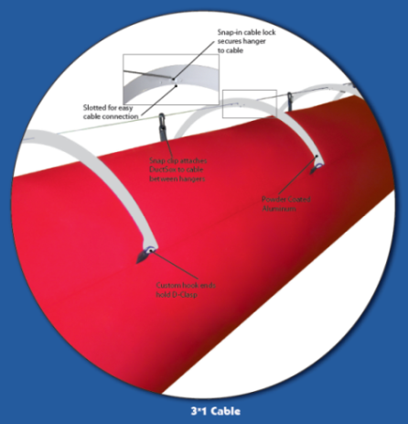
[PRESENTATION OUTLINE]
  Project Overview
  Introduction to Analyses
  Analysis I: Redesign of the Curtain Wall System
  Analysis III: Redesign of the Fichandler Stage Air Distribution System
  Conclusions
  Question & Answer
[ANALYSIS III: Redesign]
STEP 5: Suspension
  3x1 hanger suspension system
    Best aesthetics
    Smooth inflation (no “pop”)
    Easy installation
DUCTSOX DESIGN STEPS
STEP 1: Series/Shape
STEP 2: Design Layout
STEP 3: Fabric
STEP 4: Air Dispersion
STEP 5: Suspension
Construction Management
Spring 2009

Slide 39
[PRESENTATION OUTLINE]
  Project Overview
  Introduction to Analyses
  Analysis I: Redesign of the Curtain Wall System
  Analysis III: Redesign of the Fichandler Stage Air Distribution System
  Conclusions
  Question & Answer
[ANALYSIS III: Redesign]
Benefits of DuctSox
  Superior air dispersion
  Easy installation
  Balancing
  Lightweight (142 lf = 71 lbs)
  Shipping
  Flexible
  Quiet air delivery
  Air porous fabric
  Hygienic
  Launderable
Construction Management
Spring 2009

Slide 40
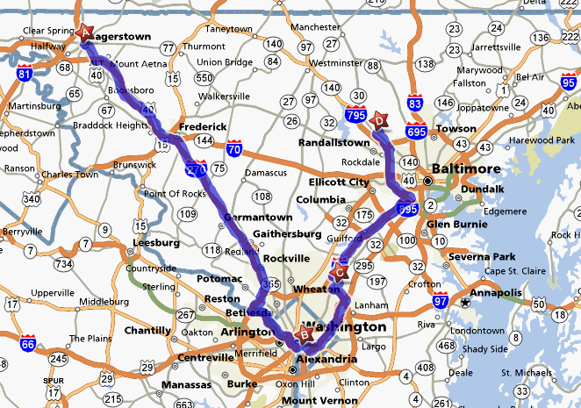
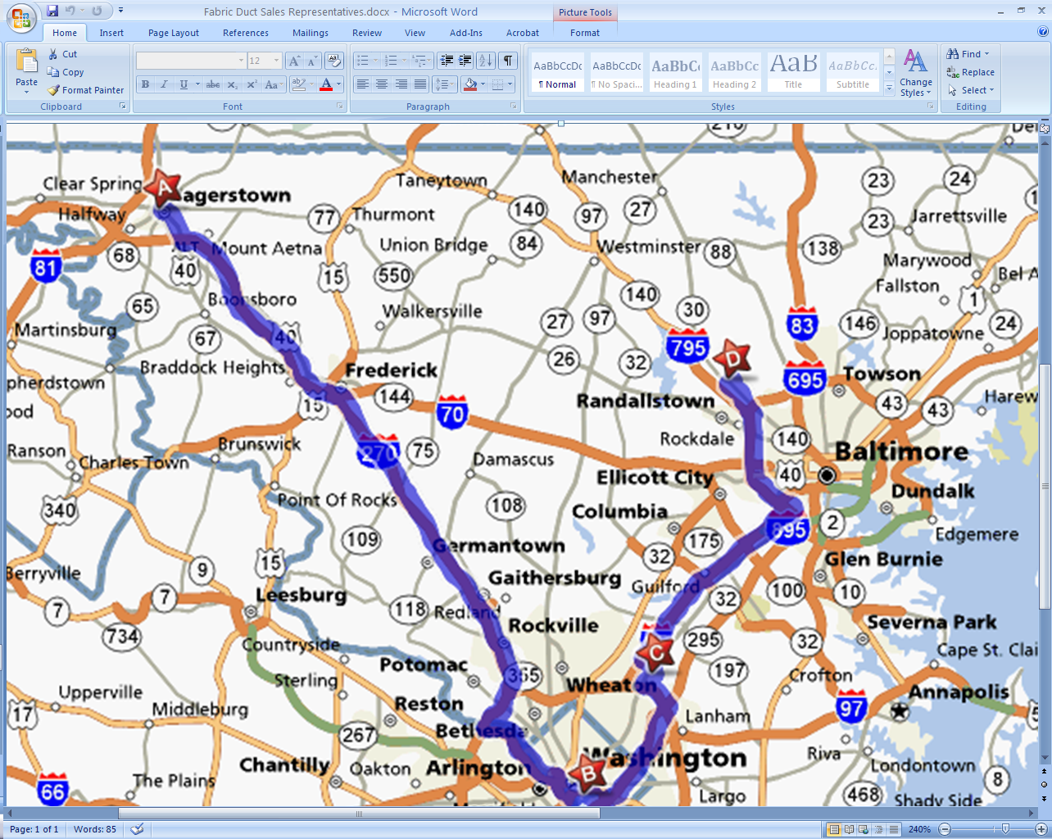
[PRESENTATION OUTLINE]
  Project Overview
  Introduction to Analyses
  Analysis I: Redesign of the Curtain Wall System
  Analysis III: Redesign of the Fichandler Stage Air Distribution System
  Conclusions
  Question & Answer
[ANALYSIS III: Companies]
Material Provider / Installer
  3 companies within close proximity to Arena Stage
Label | Company | City | State | Distance from Arena Stage
 | Ward Boland | Hagerstown | MD | 74 miles
 | Arena Stage | Washington | DC | –
 | C.G. Wood Company | Beltsville | MD | 19 miles
 | Ward Boland | Owings Mills | MD | 52 miles
Construction Management
Spring 2009

Slide 41
[PRESENTATION OUTLINE]
  Project Overview
  Introduction to Analyses
  Analysis I: Redesign of the Curtain Wall System
  Analysis III: Redesign of the Fichandler Stage Air Distribution System
  Conclusions
  Question & Answer
[ANALYSIS III: New Design]
Sheet Metal
Installation
Cost
Man Hours | Week(s) | Crew Size (men)
160 | 1 | 4
 | Unit | Multiplier | Expanded
Material | $28/LF | 186 LF | $5,210
Labor | $57.68/hr (budgeted labor rate) | 160 hrs | $9,230
Total Cost (to engineer, furnish, and install) |  |  | $14,440
Construction Management
Spring 2009

Slide 42
[PRESENTATION OUTLINE]
  Project Overview
  Introduction to Analyses
  Analysis I: Redesign of the Curtain Wall System
  Analysis III: Redesign of the Fichandler Stage Air Distribution System
  Conclusions
  Question & Answer
[ANALYSIS III: New Design]
Sheet Metal
Installation
Cost
[ANALYSIS III: New Design]
Fabric Duct
Installation
Cost
Man Hours | Week(s) | Crew Size (men)
160 | 1 | 4
Man Hours | Day(s) | Crew Size (men)
12.5 | 1 | 2
 | Item |  | Cost
Material | Duct and Fittings |  | $6,095
 | Knee Braces and Bar Joist Angle Irons |  | $250
 | Freight |  | $175
Labor | Unit | Multiplier
 | $72.50/hr (budgeted labor rate) | 12.5 hrs | $907
Total Cost (to engineer, furnish, and install) |  |  | $7,427
 | Unit | Multiplier | Expanded
Material | $28/LF | 186 LF | $5,210
Labor | $57.68/hr (budgeted labor rate) | 160 hrs | $9,230
Total Cost (to engineer, furnish, and install) |  |  | $14,440
Construction Management
Spring 2009

Slide 43
[PRESENTATION OUTLINE]
  Project Overview
  Introduction to Analyses
  Analysis I: Redesign of the Curtain Wall System
  Analysis III: Redesign of the Fichandler Stage Air Distribution System
  Conclusions
  Question & Answer
[ANALYSIS III: New Design]
Combined
Installation
Cost
[ANALYSIS III: Comparison]
54% cost reduction.
 | Man Hours | Week(s) | Crew Size (men)
Sheet Metal | 160 | 1 | 4
DuctSox | 12.5 | 0.2 | 2
Original Sheet Metal Design |  |  |  | New Design with DuctSox
Duration |  |  | Cost | Duration |  |  |  | Cost
Man Hours | Week(s) | Crew Size (men) | Total | Man Hours | Week(s) | Crew Sizes (men) |  | Total
532 | 3 | 4 | $47,990 | 172.5 | 1 | 4 | 2 | $21,867
 | Material | Labor
Sheet Metal | $5,210 | $9,230
DuctSox | $6,520 | $907
Combined | $11,730 | $10,137
Total Cost (to engineer, furnish, and install) | $21,867
Construction Management
Spring 2009

Slide 44
[PRESENTATION OUTLINE]
  Project Overview
  Introduction to Analyses
  Analysis I: Redesign of the Curtain Wall System
  Analysis III: Redesign of the Fichandler Stage Air Distribution System
  Conclusions
  Question & Answer
[ANALYSIS III: Recommendation]
Absolutely! All objectives were fully achieved.
  Closer air distribution
  Easier installation
  Installation
  1 week (67% reduction)
  Cost
  $21,867 (54% savings)
Construction Management
Spring 2009

Slide 45

[PRESENTATION OUTLINE]
  Project Overview
  Introduction to Analyses
  Analysis I: Redesign of the Curtain Wall System
  Analysis III: Redesign of the Fichandler Stage Air Distribution System
  Conclusions
  Question & Answer
[CONCLUSIONS]
Analysis I: Redesign of the Curtain Wall System
  Glazing
    Saved $1,120,000 (32%)
    Saved 66.5 days (50%)
Analysis II: Application of Photovoltaic Panels
  6 kW BIPV Array (Parking lighting)
  Material Cost: $40,409
  51 year payback period
  $15,000 rebate incentive (32 year payback)
Analysis III: Redesign of the Fichandler Stage Air Distribution System
  Saved $26,123 (54%)
  Saved 10 days (67%)
?
Construction Management
Spring 2009

Slide 46
[PRESENTATION OUTLINE]
  Project Overview
  Introduction to Analyses
  Analysis I: Redesign of the Curtain Wall System
  Analysis III: Redesign of the Fichandler Stage Air Distribution System
  Conclusions
  Question & Answer
[ACKNOWLEDGEMENTS]
Penn State Faculty:
Dr. John Messner
Dr. David Riley
Dr. Chimay Anumba
ISEC Inc:
Michael Vergari
Matthew Moore
Clark Construction Group, LLC:
Anna Samaha
Mary Thomas
Matt Galbraith
Arena Stage:
Angie Moy
Bing Thom Architects:
James Brown
Derek Kaplan
Rosalynn Chung
Southland Industries:
Jessica Baker
Shawn Cingle
StructureCraft Builders Inc:
Brian Woudstra
My Family & Scott
My Penn State AE Friends
Construction Management
Spring 2009
Notes:
I want to thank the following people for their assistance in the completion of my senior thesis project. Without their patience, support, and guidance, I would not have been able to accomplish what I have in the past year.

Slide 47
[PRESENTATION OUTLINE]
  Project Overview
  Introduction to Analyses
  Analysis I: Redesign of the Curtain Wall System
  Analysis III: Redesign of the Fichandler Stage Air Distribution System
  Conclusions
  Question & Answer
[ACKNOWLEDGEMENTS]
[Questions?]
Penn State Faculty:
Dr. John Messner
Dr. David Riley
Dr. Chimay Anumba
ISEC Inc:
Michael Vergari
Matthew Moore
Clark Construction Group, LLC:
Anna Samaha
Mary Thomas
Matt Galbraith
Arena Stage:
Angie Moy
Bing Thom Architects:
James Brown
Derek Kaplan
Rosalynn Chung
Southland Industries:
Jessica Baker
Shawn Cingle
StructureCraft Builders Inc:
Brian Woudstra
My Family & Scott
My Penn State AE Friends
Construction Management
Spring 2009

Slide 48

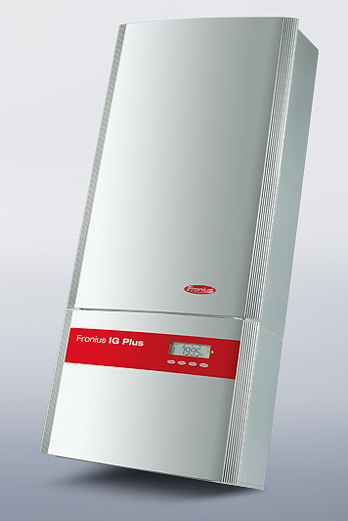
[PRESENTATION OUTLINE]
  Project Overview
  Introduction to Analyses
  Analysis I: Redesign of the Curtain Wall System
  Analysis III: Redesign of the Fichandler Stage Air Distribution System
  Conclusions
  Question & Answer
[ANALYSIS II: PV Panels]
Information
  Sun path study
  Shadow analysis
  Parking garage lighting load = 6kW
  BIPV – Uni-Solar 144 Watt Solar Laminate Module (PVL-144)
    Roof: Hot asphalt and TPO sheet membrane
  Inverter – Fronius IG Plus 6.0-1
EDSGN 498A
  Array to Inverter Matching Program
  5 strings, 9 modules in series
  45 modules total (23.25 ft²)
  93% Inverter max output
[ANALYSIS II: PV Panels]
Cost
  Modules
    $800 per module (Advanced Green Technologies Rep)
    $36,000 total
  Inverter
    $4,409 (Online quote)
  PV Watts
    Electricity cost = $0.08/kWh (*no inflation)
    51 year payback period
  Incentives (DDOE REIP)
    Eligible for $15,000 rebate
    32 year payback period
    *No tax
*Not taken into consideration
Construction Management
Spring 2009
Notes:
District Department of the Environment
Renewable Energy Incentive Program

